Slide 1
Clean Water
Danae Dieken
Cornerstone

Slide 2
Attention Please!
One Drop Documentary, “Some people believe our lives are so small they’re like a single drop of water in a rain storm. At face value what is a drop of water? Small, undetected, it could dry up and no one would notice. But, think of a time when it was about to rain. Your outside, sky above you is a dark grey, you look up at the clouds, and a drop of water lands on your cheek. Suddenly a fleet of water drops begin to fall. As if they were all following that first drop. At face value a drop of water isn’t much, but without any drops there would be no lakes, no rivers, or oceans, and from that perspective one drop is as vital as any.”

Slide 3
You can be that one drop
We can change the world by the year 2040!

Slide 4
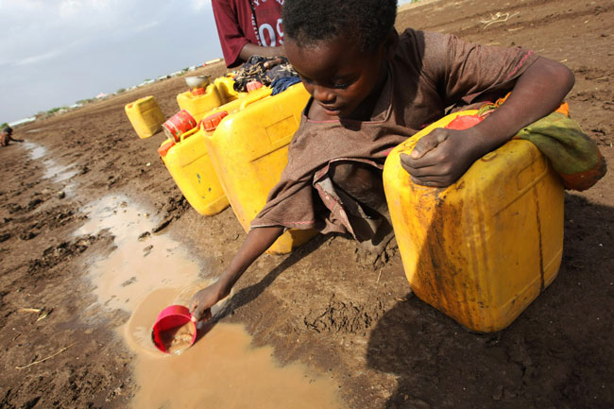
Need
1 in 6 people world-wide lack
clean water- UNICEF
The average rural African spends 5 hours a day walking to get water.- The Water Project
443,000,000 days of school missed yearly, because of children having to walk for water - The Water Project
½ the world’s hospital beds are occupied by people by people with a waterborne illness- United Nations
Less than 1 in 3 people in rural Africa have a toilet- World Health Organization

Slide 5
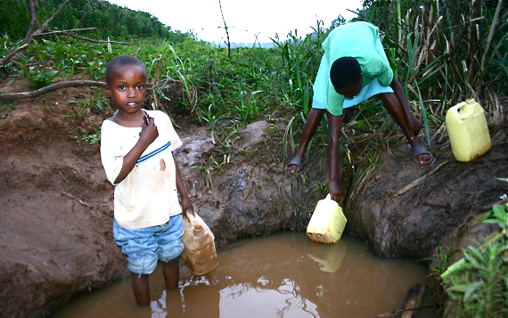
Need
John Rosco’s story

Slide 6
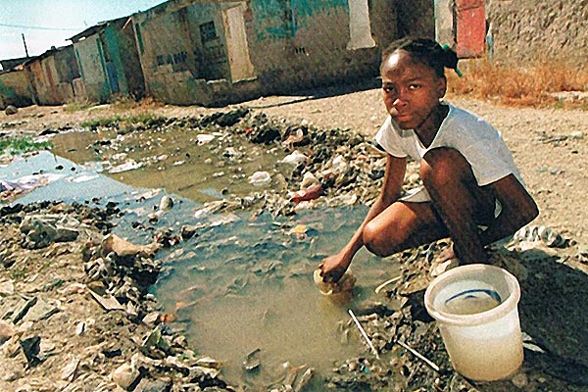
Need
Asha’s story

Slide 7
Need for Water
Every day each one of us uses 140 gallons or more.
While every rural African only uses 4.
40 billon hours a year are spent on collecting water every year in Africa alone. (Entire work force of France)
$20=1 water project
All the facts found at wishing well’s website

Slide 8
Satisfaction
Water bottles
UNI
Clean Water Movement

Slide 9
Satisfaction
“Research has shown that for every 10% increase in women's literacy, a country's whole economy can grow by up to 0.3%.” United Nation’s report.
According to the World Health Organization, “for every $1 invested in water and sanitation, there is an economic return of between $3 and $34!”

Slide 10
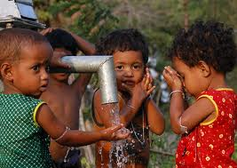
Visualization
“The global water crisis claims more lives than cancer, AIDS and war. We aim to change that (C.W.M 2013).”
We can change it now.

Slide 11
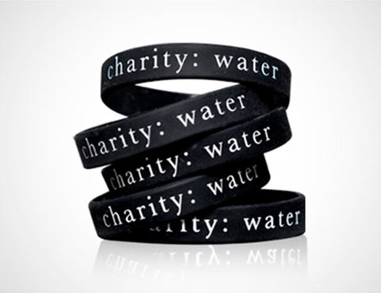
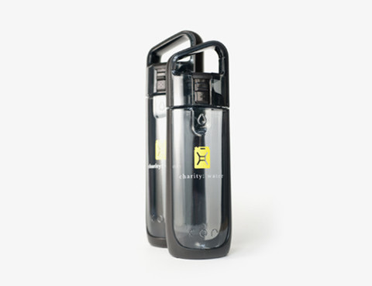
Action

Slide 12
Action
One Drop
5:10-5:40-5:54

Slide 13
Clean Water
Danae Dieken
Cornerstone

Slide 14
Reference
AQUASTAT. Food and Agriculture Organization of the United Nations. "Water Use." http://www.fao.org/nr/water/aquastat/water_use/index.stm
WHO/UNICEF Joint Monitoring Programme for Water Supply and Sanitation. "Progress on Sanitation and Drinking Water 2010." Available at www.wssinfo.org/
UNICEF. "Water, Sanitation and Hygiene" Updated May 2010. http://www.unicef.org/media/media_45481.html
United Nations Development Programme. "Human Development Report 2006: Beyond Scarcity: Power, Poverty and the Global Water Crisis." 2006. Available athttp://hdr.undp.org/en/reports/global/hdr2006/
United Nations. Statement by Secretary General Koffi Annan. June 2003. http://www.un.org/News/Press/docs/2003/sgsm8707.doc.htm
WHO/UNICEF. "Diarrhoea: Why children are still dying and what can be done." 2009. available at http://www.unicef.org/health/index_51412.html.
World Health Organization. "Costs and benefits of water and sanitation improvements at the global level."http://www.who.int/water_sanitation_health/wsh0404/en/
United Nations Development Programme. "Human Development Report 2006: Beyond Scarcity: Power, Poverty and the Global Water Crisis." 2006. Available athttp://hdr.undp.org/en/reports/global/hdr2006/
Jerry cans carry approx. 5 gallons of water so if a single gallon of water weighs 8.3 pounds, 5 gallons are 41.5 pounds.
United Nations Development Programme. "Resource Guide on Gender and Climate Change." 2009. Available athttp://www.undp.org/climatechange/library_gender.shtml
UNICEF. "Water, Sanitation and Hygiene" Updated May 2010. http://www.unicef.org/media/media_45481.html
World Health Organization. Executive Summary of "Costs and benefits of water and sanitation improvements at the global level."www.who.int/water_sanitation_health/wsh0404summary/en/
Based on 87% of the global population using imprtoved sources. Found in WHO/UNICEF Joint Monitoring Programme for Water Supply and Sanitation. "Progress on Sanitation and Drinking Water 2010." Available at www.wssinfo.org/

