Slide 1
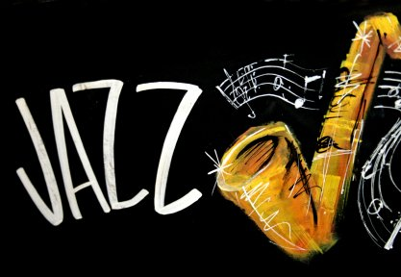
Danae Dieken, Cornerstone 2012

Slide 2
Preview
Humble Beginnings
Rise of Jazz
Modern Jazz

Slide 3
Humble Beginnings
Ragtime & Street Performances
Birthplace, New Orleans

Slide 4
Humble Beginnings
Early Dancing, Farley found…
“The earliest Jazz was used in dancing. Slaves would gather together at the end of a harvest and celebrate with dances complete with costumes.”
“Black Codes’ enforced by the government made it illegal for slaves to drum”
Twenty years after the ‘Black Codes’, after the end of the Civil war, African American’s were allowed military drums.”

Slide 5
Humble Beginnings
Church Influence
“Slaves learned the harmonic style of the blues from church hymns.” (Crooke)

Slide 6
Rise of Jazz “The Jazz Age’
“The birth of jazz music is often accrediated to African Americans, but expanded and over time was modiied to become socially acceptable to middle-class white Americans. White performers were used as a vehicle for the popularization of jazz music in America. Even though the jazz movement was taken over by the middle class white population, it facilitated the mesh of African American traditions and ideas with the white middle class society.” (Barlow)

Slide 7
Modern Jazz
Performance
“There is another dimension of improved music that extends into the social. Musical improvisation exists in the web of the particulars of time and space, of history, and of culture. This fact allows for the possibility of another mode of engagement with… (continued)

Slide 8
Modern Jazz
… (Continued) musical improvisation. It is not just that improvisation provides a vivid instance of human shaping or even that it offers, in some sense, a model of thinking and action. Particular improvisations may have an import derived from concrete historical situations.” (Day)

Slide 9
Modern Jazz
Shame - Lacking Improvisation
“Jazz is at a crossroads where it can become a concerto or stay what it has always been.” (Day)

Slide 10
Modern Jazz
Disney’s Influence
Jungle Book
Princess and the Frog
Latina Spin
Radio Hits
Jimi Hendrix, Run DMC, Funk

Slide 11
Review
Humble Beginnings
Rise of Jazz
Modern Jazz

Slide 12
Jazz
Danae Dieken, Cornerstone 2012

