Slide 1
Traditions Challenge
Danae Dieken

Slide 2
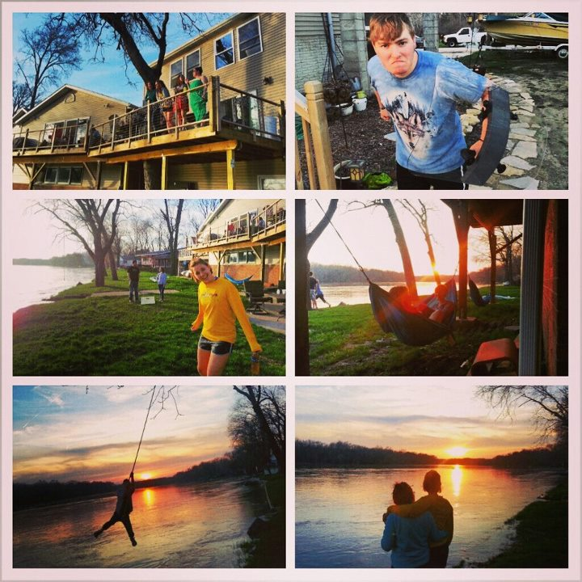
Student Organizations
I was a part of the student leadership for BASIC. This is our end of the year party.

Slide 3
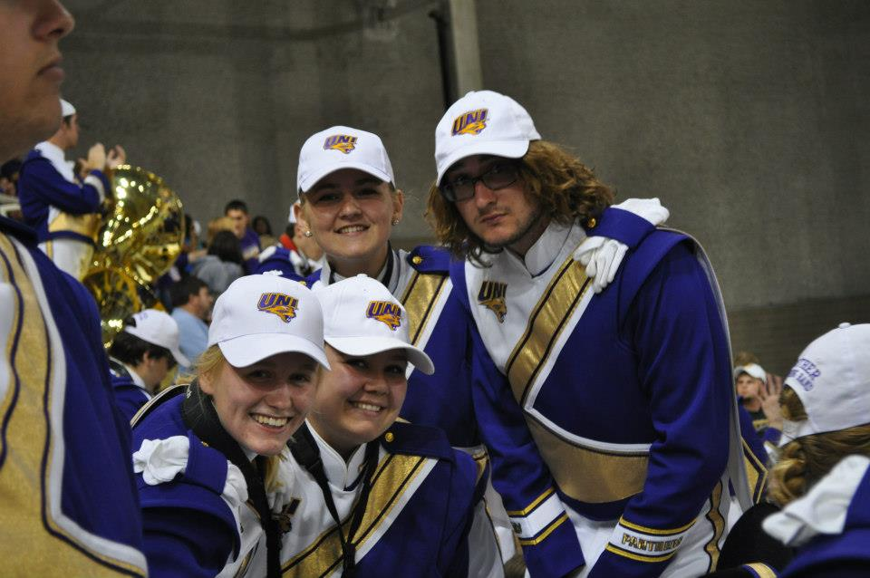
Football

Slide 4
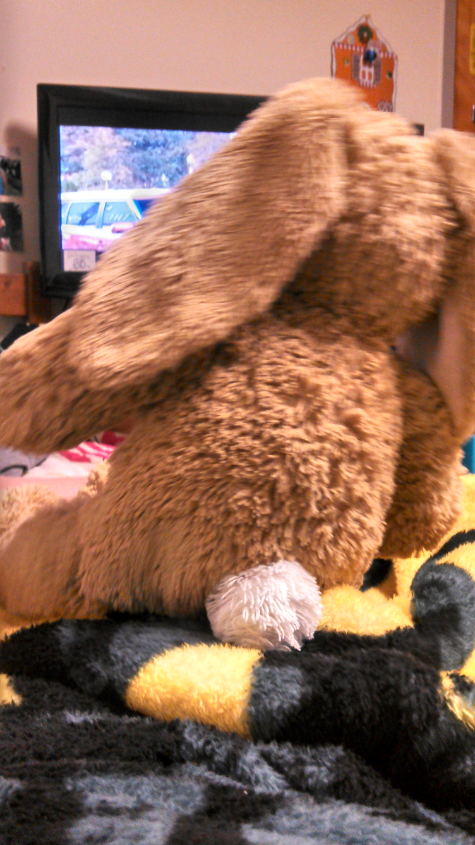
Residence Hall

Slide 5
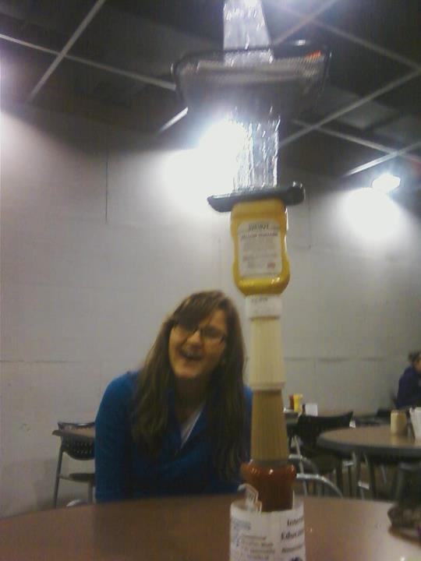
Dinning
I got really good at stacking things. (did you notice my phone in there?)

Slide 6
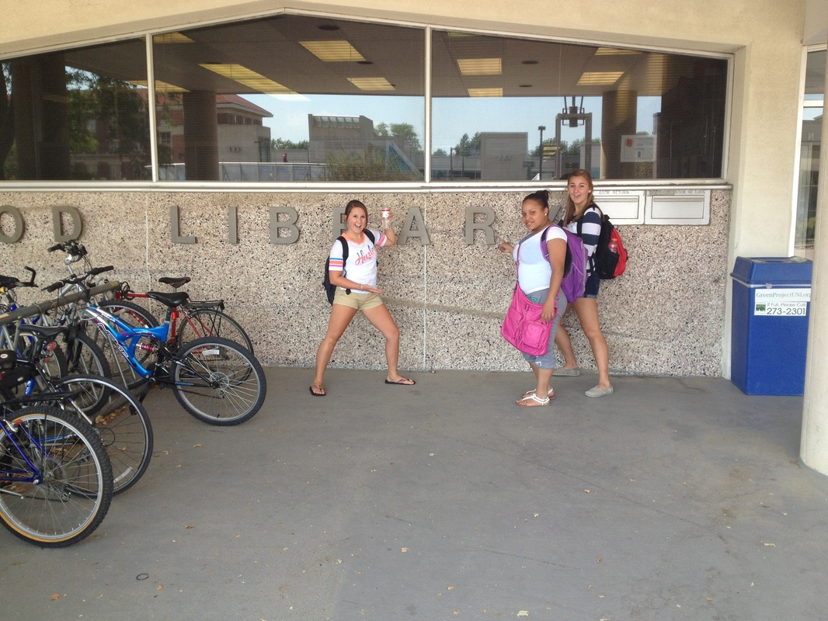
Rob Library

