Slide 1
Traditions Challenge 4

Slide 2
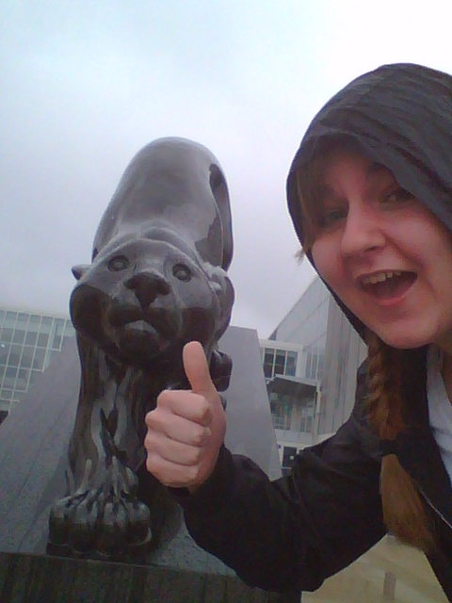
Granite panther

Slide 3
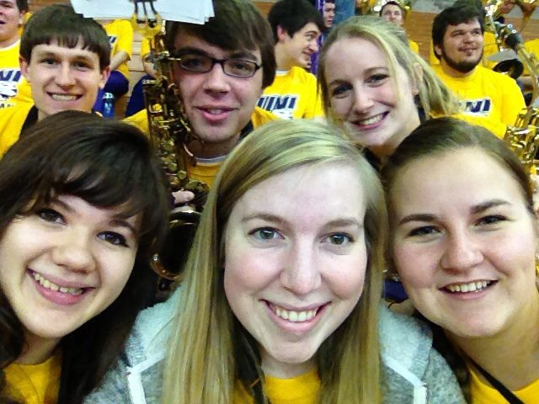
Interlude
I realize we aren’t interluding in this picture, but many time the pep band will venture into the student section to fill it up for the interlude!

Slide 4
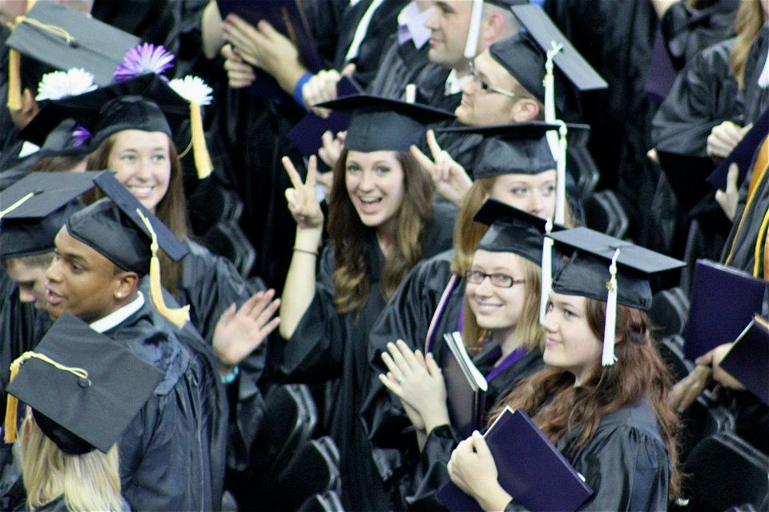
Commencement
My small group leader from high school Kate at graduation!

Slide 5
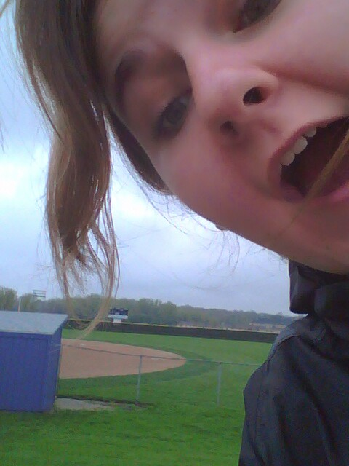
Softball

Slide 6
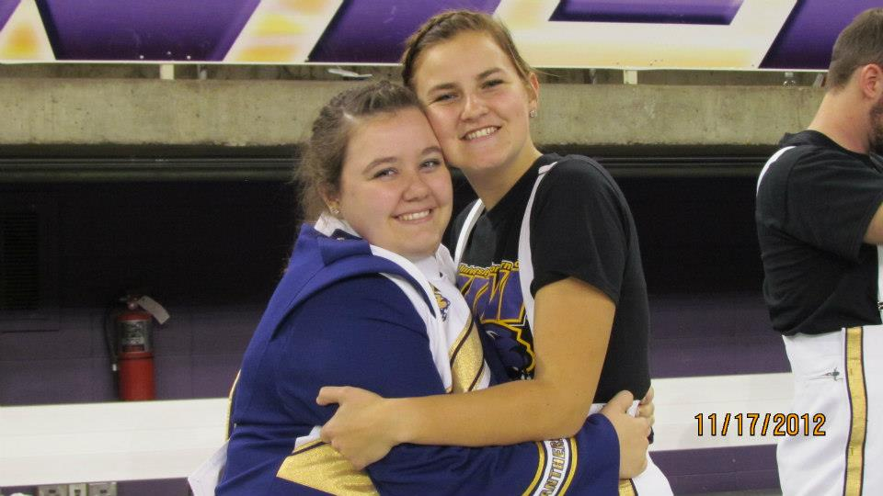
Football

Slide 7
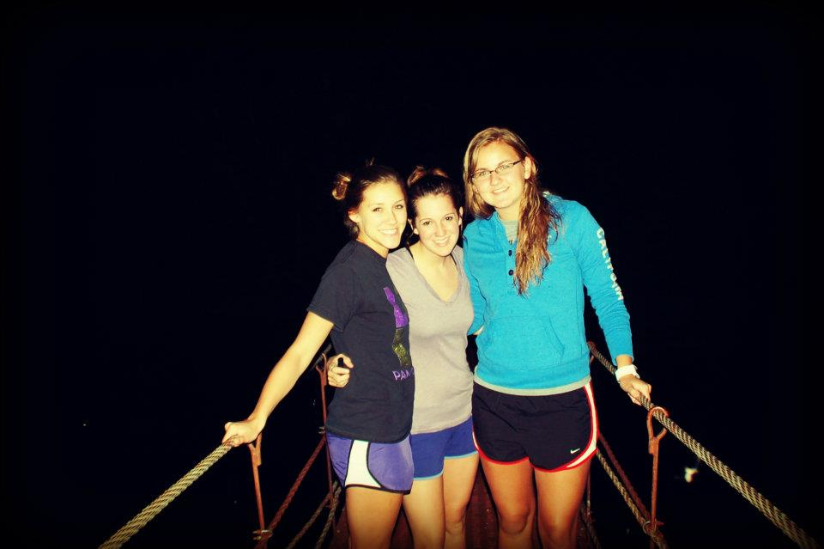
Start your own tradition: Exploring Cedar falls bridges!

Slide 8
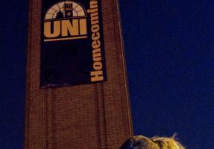
Campaniling
This was very awkward
Since I did not participate.

Slide 9
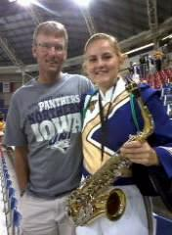
Family weekend

Slide 10
Summary
What I liked best: I loved volunteering in St. Louis. I used this experience for philanthropy.
What I struggled with: I struggled the most with the most was Campaniling. It was awkward. I don’t think I will go solo again. Too weird.
What would I do different: I would have started volunteering at Salvation Army first semester.

