Slide 1
Traditions Challenge Part 3

Slide 2
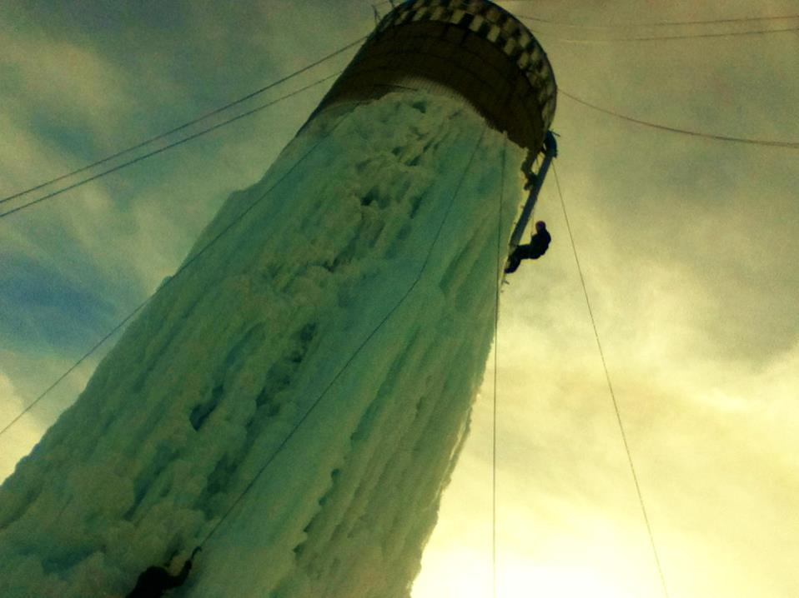
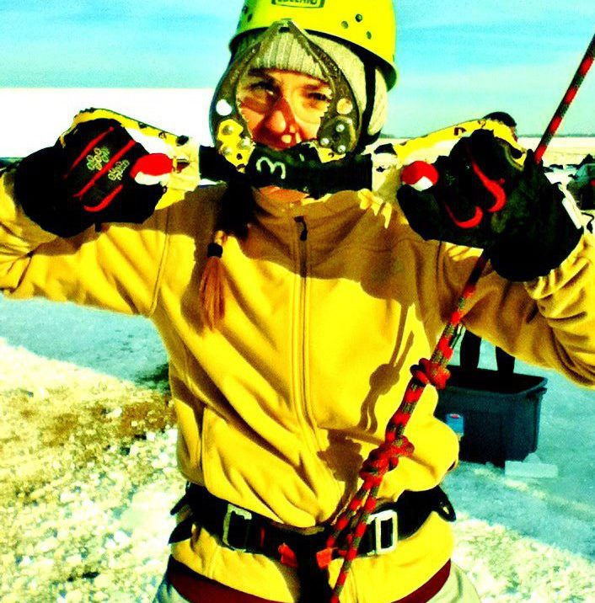
WRC
My Silo Ice climbing Class was taught through the WRC

Slide 3
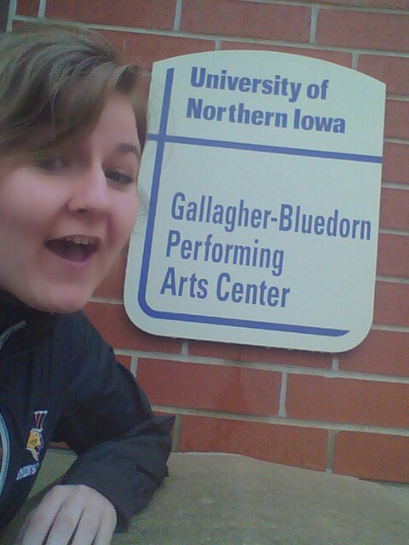
Gallagher-Bluedorn

Slide 4
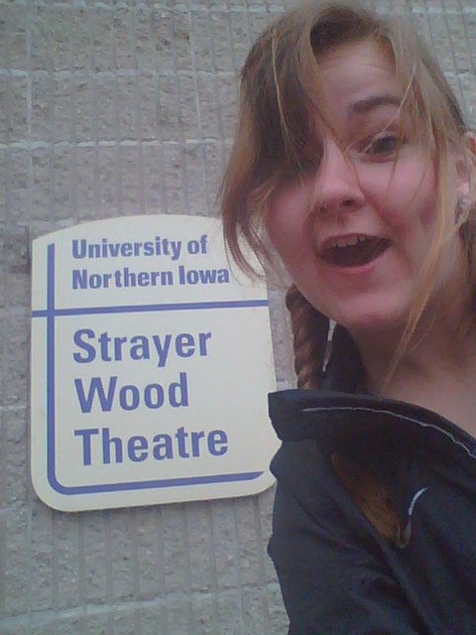
Strayer Wood theatre

Slide 5
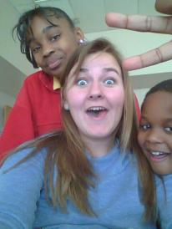
Volunteer
Teaching Literacy at the Salvation Army in Waterloo!

Slide 6
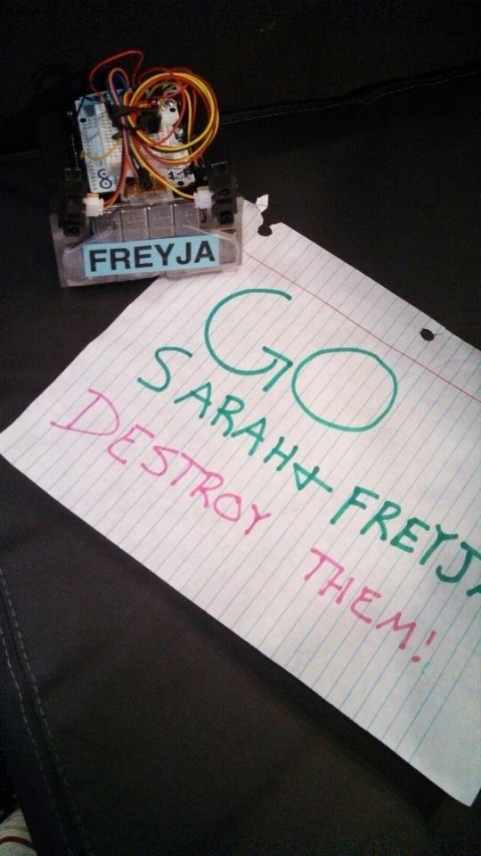
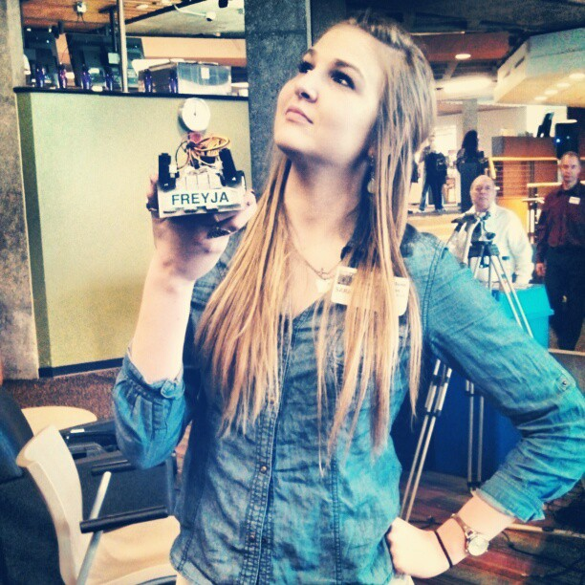
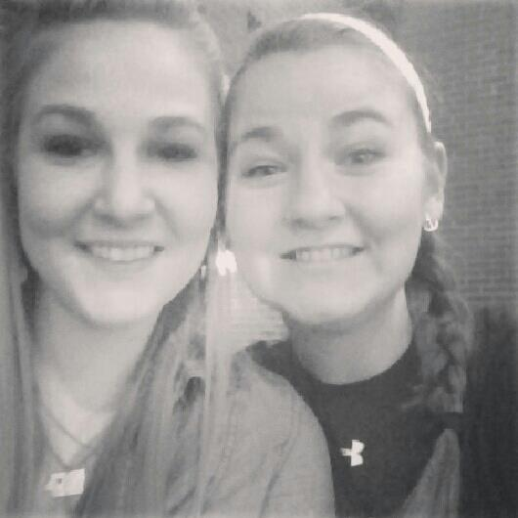
Maucker Union
UNI Robotics Club Mini Sumo Fighting Robot Completion that my sister’s robot competed in was hosted in the Maucker Union.

Slide 7
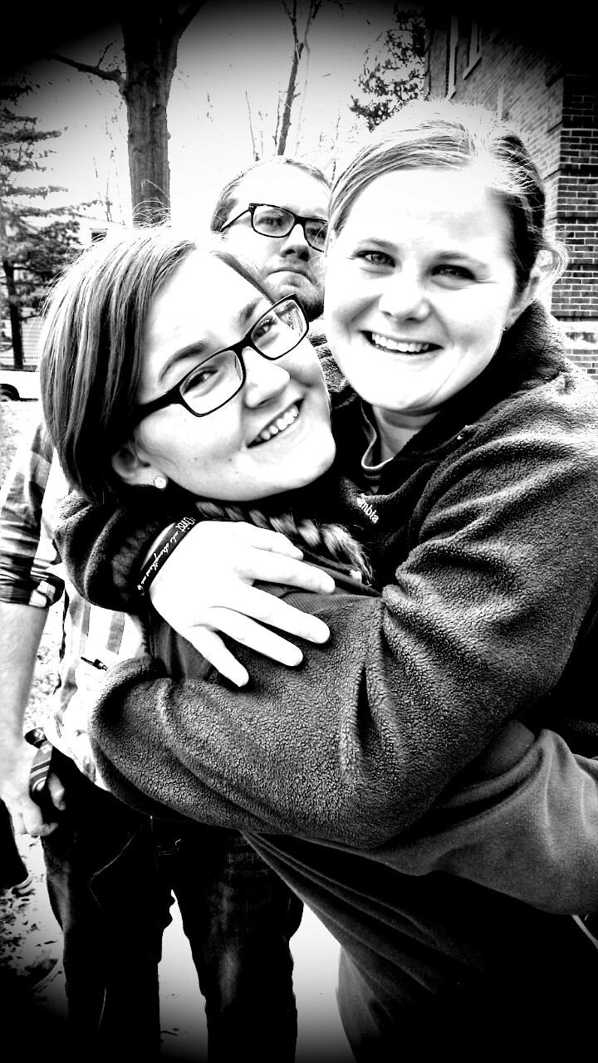
Intramurals
Jessi and I were on the same intermural basketball team, the Acaballers. The team consisted of quite a few rugby players, me, a girl on the golf team, and my sister. I was asked to be on it, because I was tall. It was interesting. I was not quite as athletic as the other girls.

